Slide 1

Video Game Sales
STAT515 FINAL PROJECT GROUP 4

Slide 2
ABOUT Data
The "Video Games Sales Analysis and Visualization" dataset contains information on over 16,500 video games, including sales figures from different regions of the world.
Source: https://www.kaggle.com/datasets/rush4ratio/video-game-sales-with-ratings

Slide 3
Research questions
QUESTION 1
Are certain genres of games more popular in specific regions?
QUESTION 2
How has the video game industry evolved over time?
QUESTION 3
Are there any relationships between critic and user scores and sales?

Slide 4
Methodology
Environment Setup
Loading required packages to set up the environment. Such as ggplot2, tidyr, dplyr, and viridis
Data Pre-processing and Cleaning
Handling missing values, data quality issues, and inconsistencies.
Exploratory Data Analysis
Using descriptive statistics and visualization techniques to understand the data distribution and identify patterns.
Predictive Modeling
Using machine learning techniques to predict video game sales based on available data.

Slide 5
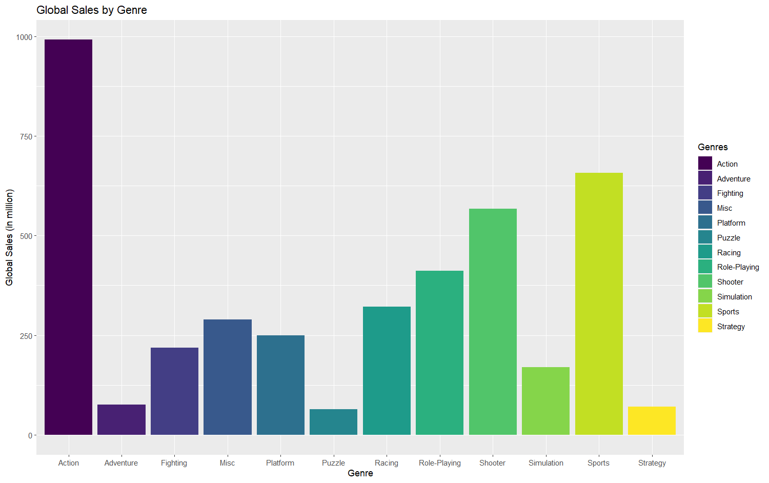
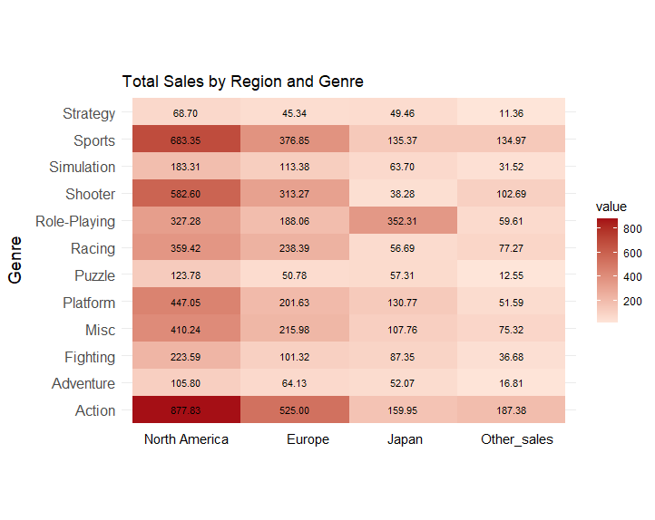
Research Question 1

Slide 6
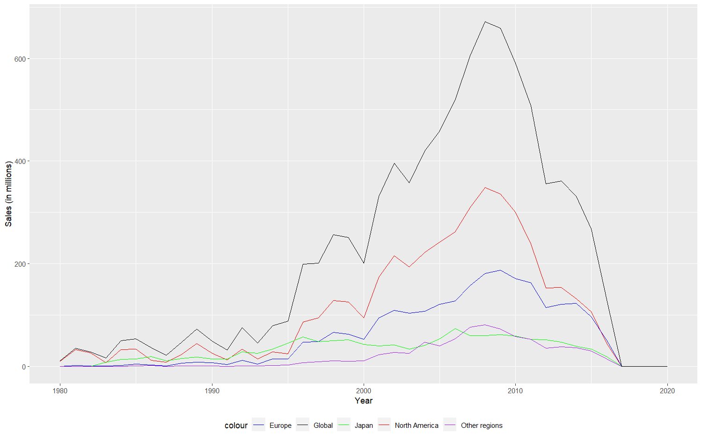
Research Question 2

Slide 7
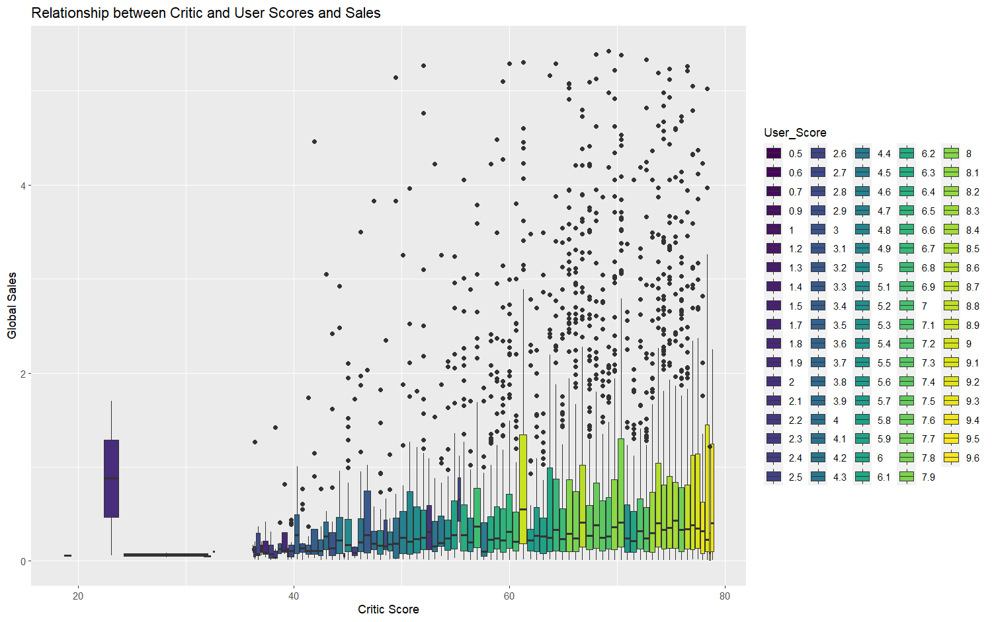
Research Question 3

Slide 8
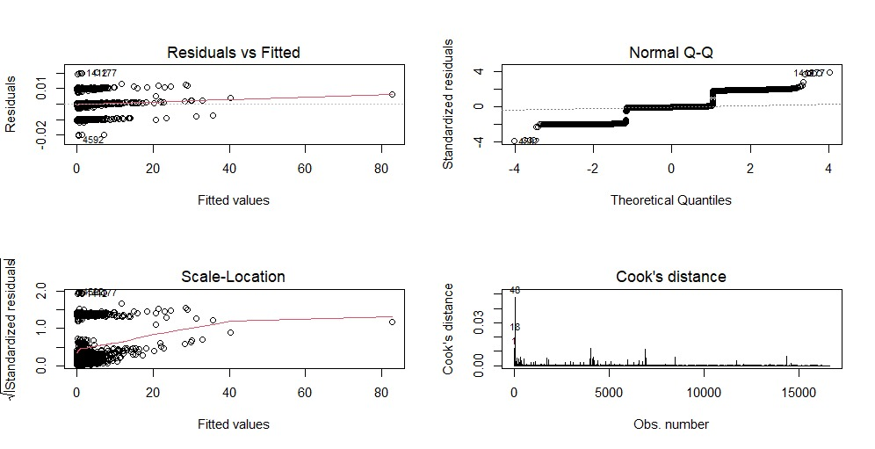
Multiple Linear MODEL

Slide 9
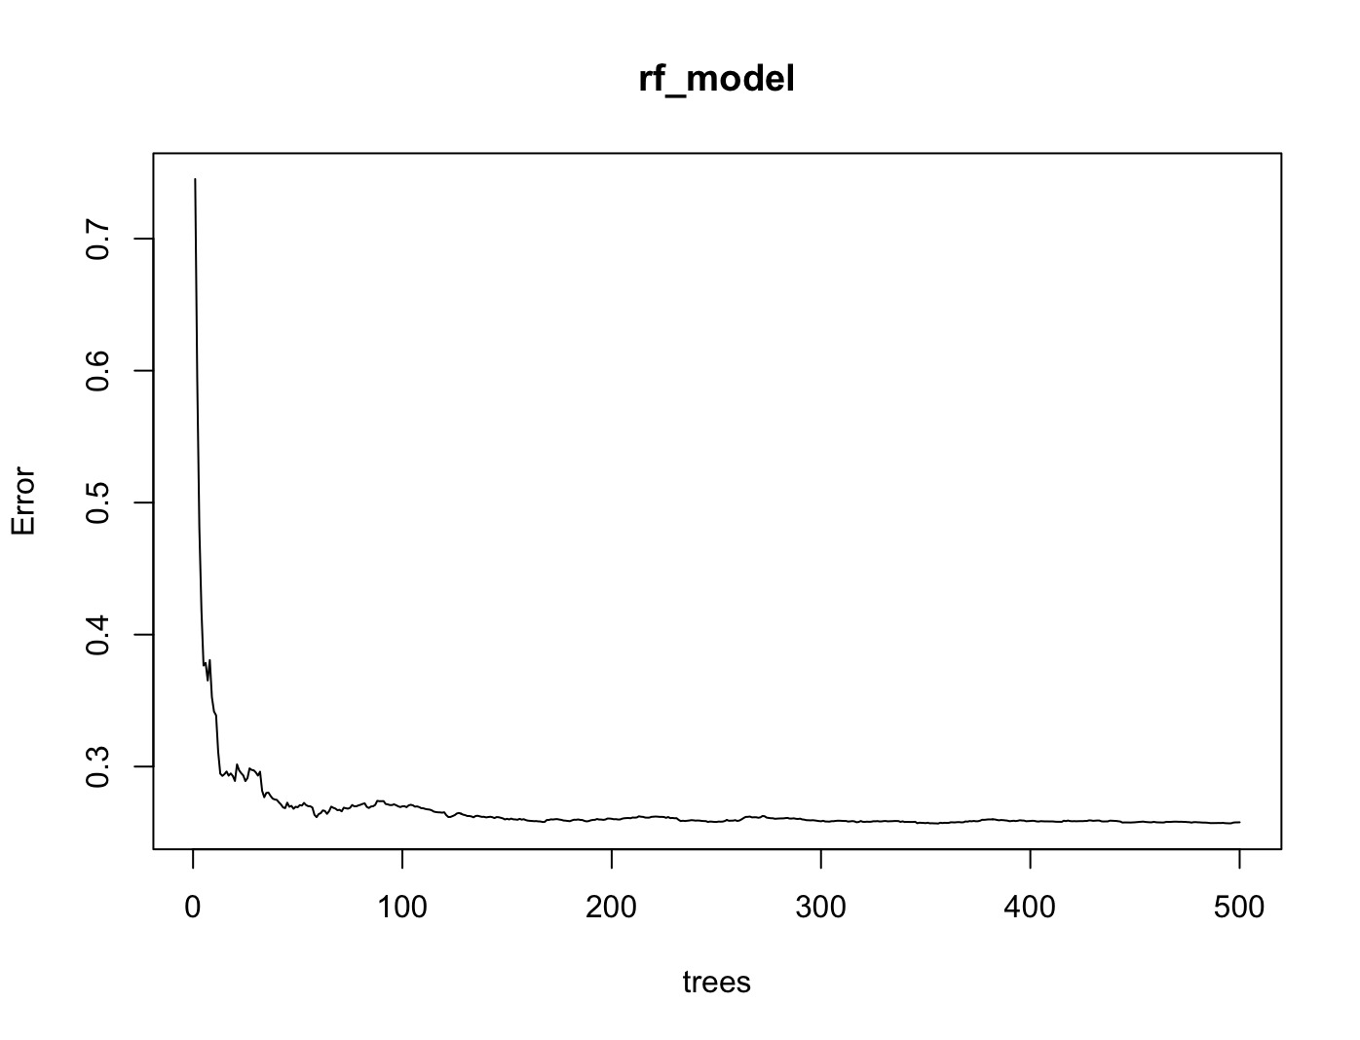
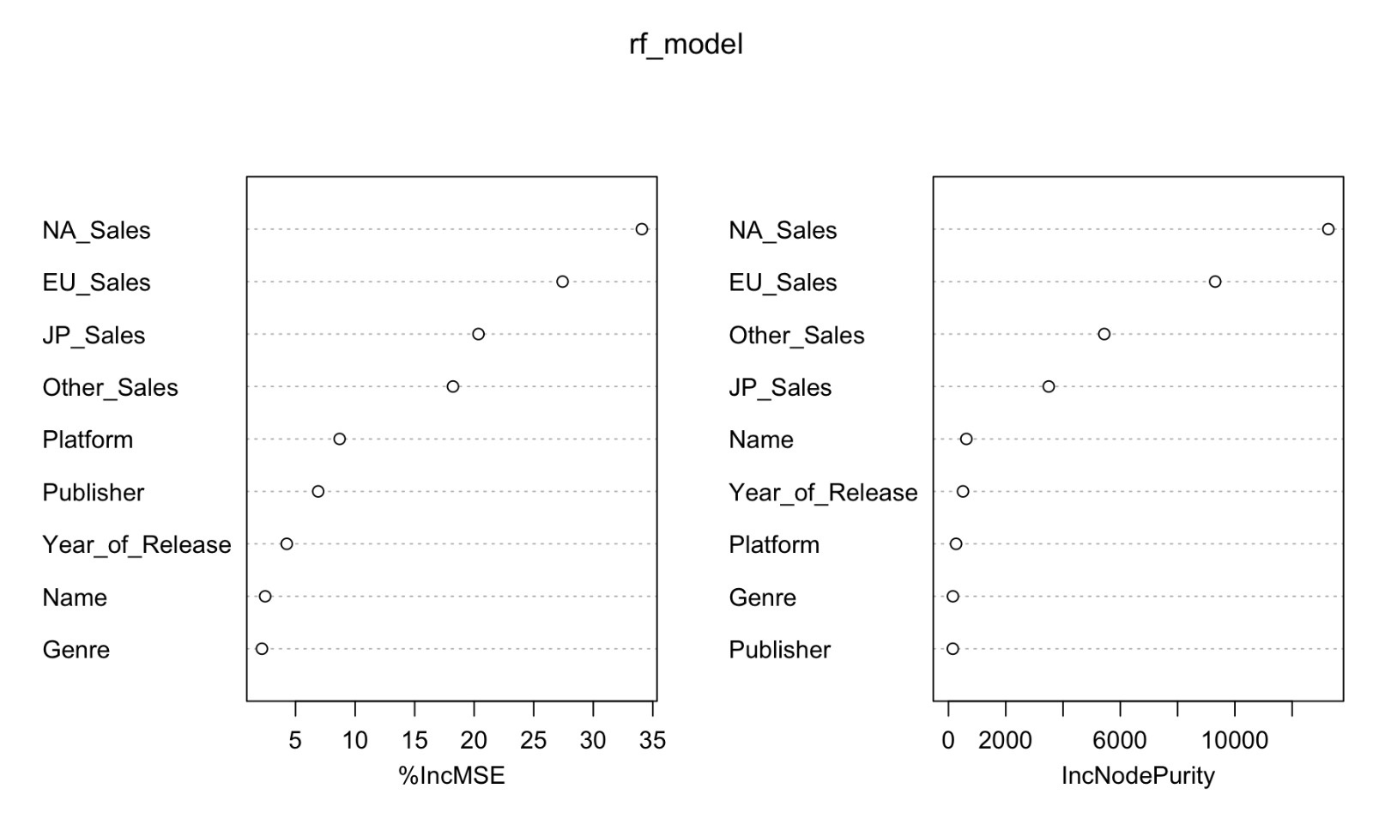
Random forest model

Slide 10
Conclusion
In conclusion, our analysis of the video game sales dataset has revealed some interesting insights into the industry. Game developers should be aware of regional differences in genre preferences and should stay up to date with changing trends in order to be successful. Additionally, critical reviews may be more important than user reviews when it comes to sales.

Slide 11
THANK YOU
Vishal Orsu • Rishik Ragi • Manish Pannala

